Slide 1







Team 103
Grocery Store Review Analysis
CIS 509 - Prof. Tian Lu

Slide 2


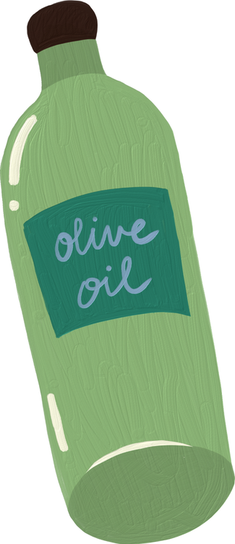


Introduction : Why analyze grocery store reviews?
Customers rely on online reviews to choose grocery stores: Digital reviews serve as trusted sources of information, influencing customer decisions.
Understand satisfaction & dissatisfaction drivers: Identifying what customers love (e.g., quality, service) and areas of frustration (e.g., wait times, stock issues) helps improve the experience.
Review insights inform pricing, layouts & staff management: Reviews reveal customer perceptions of value, product placement preferences, and service quality, guiding strategic decisions in pricing, store design, and staffing.

Slide 3


Project Objective
Goal: Identify factors influencing customer satisfaction & business performance in grocery stores
Objective: Understand the key drivers of positive and negative customer experiences, with the aim of improving both customer satisfaction and overall business success.
Actionable insights for grocery store managers & marketing teams:
Provides data-driven guidance to help managers make informed decisions about store operations, product offerings, and customer service.
Helps marketing teams refine strategies to enhance customer engagement, attract new shoppers, and increase brand loyalty.
Helps businesses address negative feedback & enhance customer retention:
Identifying pain points from customer feedback allows businesses to proactively address issues (e.g., long checkout lines, poor service) and prevent losing customers.
Understanding satisfaction drivers enables stores to continuously improve their offerings, fostering customer loyalty and repeat business.

Slide 4


Research Questions
1. What are the most common factors affecting customer satisfaction?
2. How do ratings correlate with store location, pricing, and attributes?
3. What insights can be derived from sentiment analysis?
4. What marketing strategies can stores use based on customer feedback?

Slide 5




Industry Statistics & Data Overview
Dataset Source: Yelp reviews for grocery stores in Arizona
Focus: Analysis of customer feedback from one of the most popular review platforms for local businesses.
Relevance: Yelp is frequently used by consumers to share their shopping experiences and make informed decisions.
Total Reviews Analyzed: 8000
Most Reviewed Stores:
Trader Joe’s: Known for its unique products and friendly atmosphere.
Target: Popular for a variety of goods, including groceries and household products.
Safeway: Recognized for its wide range of grocery items and convenient locations.
Fry’s: A go-to option for competitive pricing and diverse product offerings.

Slide 6
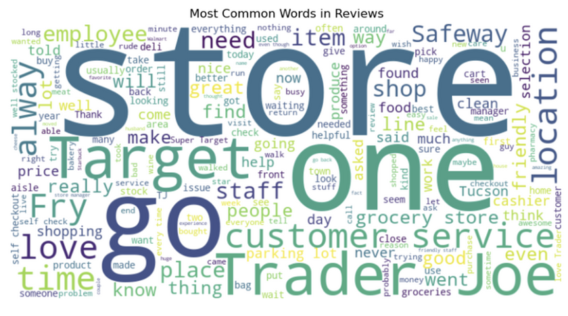
Dataset Summary
Dataset Overview
• 8,000 customer reviews
• Contains review texts, ratings, business names, locations
Data Cleaning
• Missing Values: 10 missing in attributes, 64 in business hours
• Outliers: Found in review counts & ratings (addressed using boxplots)
Insights & Visualization
• Sentiment Score Analysis: Mean, median, standard deviation
• Word Cloud: Highlights frequently mentioned words in reviews

Slide 7
Suitability & Bias
Challenges & Tackling
Why This Dataset is Useful
• Identifies trends in customer behavior & business performance
• Helps businesses understand customer satisfaction & areas for improvement
Potential Biases
• Review Bias: Extreme opinions (either really positive or really negative) dominate, neutral opinions are often missing
• Geographical Bias: Data limited to specific locations
• Business Selection Bias: Large businesses overrepresented
• Fake Reviews: Some businesses may manipulate ratings (boost their ratings by posting or encouraging artificial reviews)
Challenges in Working with Text Data
• Messy, full of slang, hard to interpret
• Requires cleaning (removing noise, slang, inconsistencies)
• Handling missing values & extreme outliers
Processing Techniques Used
• Sentiment Classification: Categorizing reviews as positive, neutral, or negative
• Topic Modeling: Identifying key themes in reviews
• Predictive Analytics: Helping businesses track trends & make data-driven decisions

Slide 8

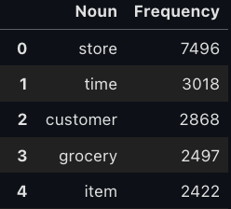
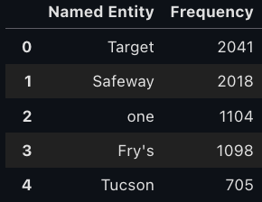
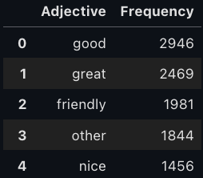
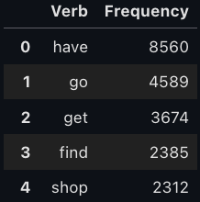
Named
Entity Recognition
Extracted key entities like store names, locations, and competitor mentions.
Insights
Target, Safeway, Fry’s were the most mentioned stores, indicating customer engagement.
Mentions of locations (e.g., Tucson:705) highlighted regional sentiment differences.
Top Words in Reviews
Nouns: "store," "time," "customer" → Focus on shopping experience and service
Adjectives: "good," "great," "friendly" → Positive customer sentiment
Verbs: "have," "go," "get" → Action words reflecting purchase behavior
Named Entities: "Target," "Safeway," "Fry’s" → Most mentioned stores
Insights
✔ Customers talk about store experience & time spent shopping.
✔ Positive descriptors highlight customer satisfaction drivers.
✔ Stores should optimize service based on frequent mentions.
✔ Helps grocery stores understand brand perception and competitive positioning.

Slide 9
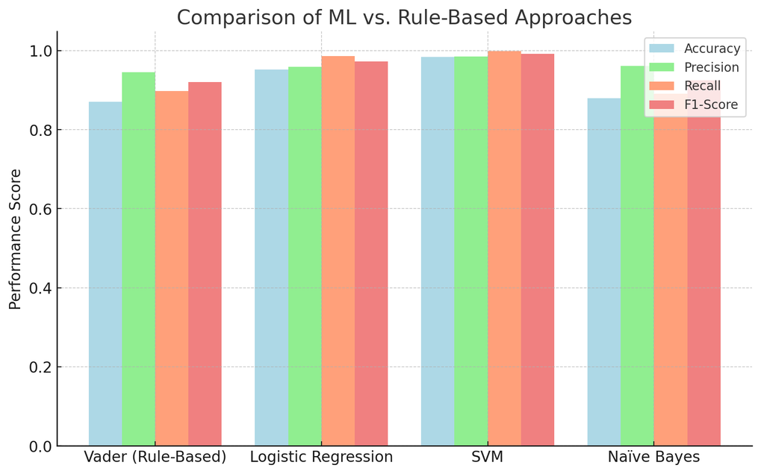
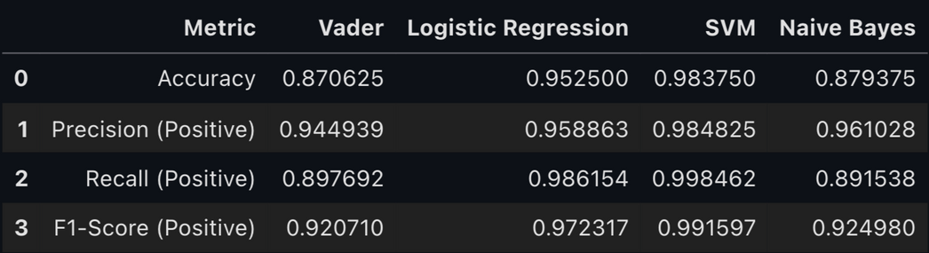


Models used in Sentiment Analysis
Sentiment analysis helps businesses understand customer emotions in reviews.
Traditional approaches (Rule-Based Methods) struggle with context
Machine Learning (ML) models for better accuracy and adaptability
Models Used in This Project:
Vader (predefined lexicon) – Fast and efficient, but lacks contextual understanding
Naïve Bayes – Works well for simple text but struggles with complex sentence structures
Logistic Regression (High Precision: 98.4%)
Learns relationships between words & sentiment.
Performs well with structured data but can struggle with non-linear sentiment expressions
Support Vector Machine (SVM) (High Accuracy: 98.4%)
Finds optimal decision boundaries between sentiment classes.
Best performer is with the highest accuracy and robustness.

Slide 10




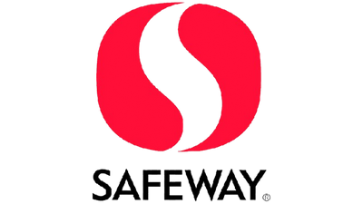

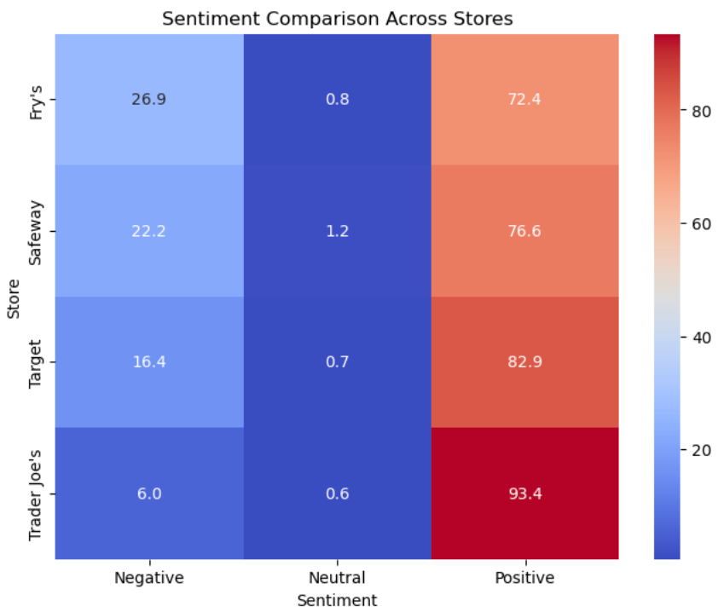
Sentiment Comparison
Takeaways from Sentiment Analysis
Trader Joe’s: Highest positive sentiment (93.4%), strong brand loyalty.
Target: High customer satisfaction (82.9%), minimal negative sentiment.
Safeway: Moderate satisfaction (76.6%), but some pricing & service concerns.
Fry’s: Highest negative sentiment (26.9%), indicating service issues.
Business Insights
Fry’s should focus on improving customer service and product availability.
Safeway needs to address complaints about pricing and quality.
Target should work on eliminating minor negative feedback to enhance reputation.
Trader Joe’s should maintain its strong customer engagement and unique shopping experience.

Slide 11

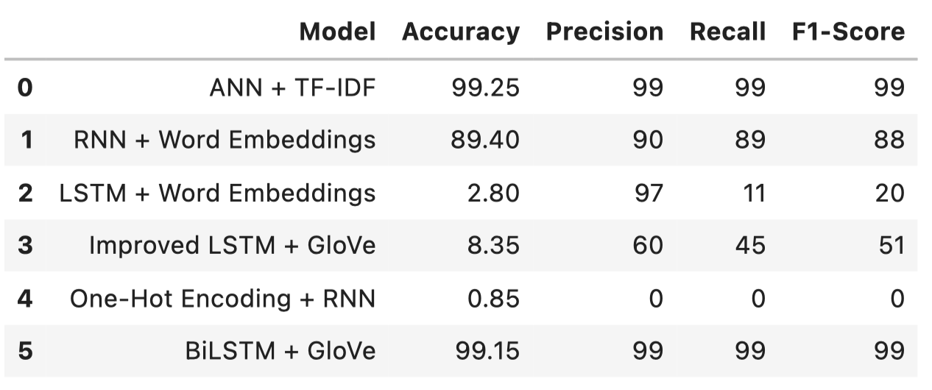


Deep Learning Models
best
for
bad
Topic Modeling
Best Performing Models : High accuracy and contextual understanding
BiLSTM + GloVe - GloVe embeddings helped with semantic representation, crucial for distinguishing topics
ANN + TF-IDF - Fast & efficient especially when combined with LDA (Latent Dirichlet Allocation) or NMF (Non-negative Matrix Factorization)
Poor Performing Models : LSTM + Word Embeddings & One-Hot Encoding + RNN
Training issues, Low Recall & Accuracy, does not retain word meanings, making it ineffective

Slide 12
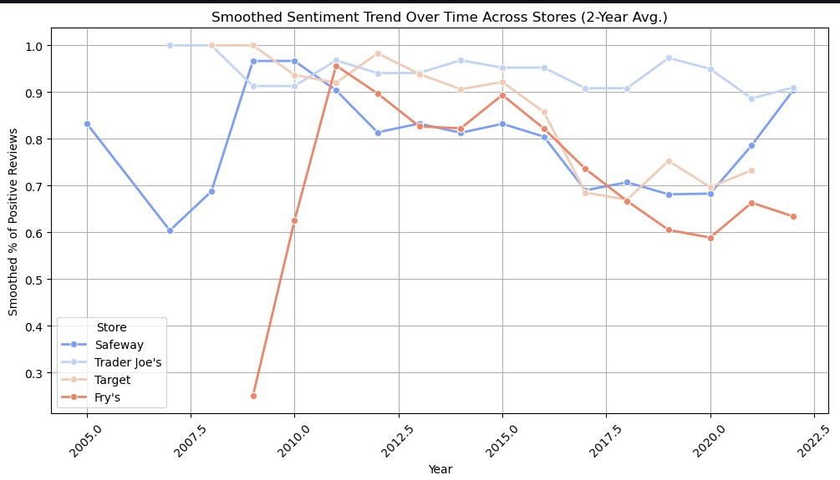
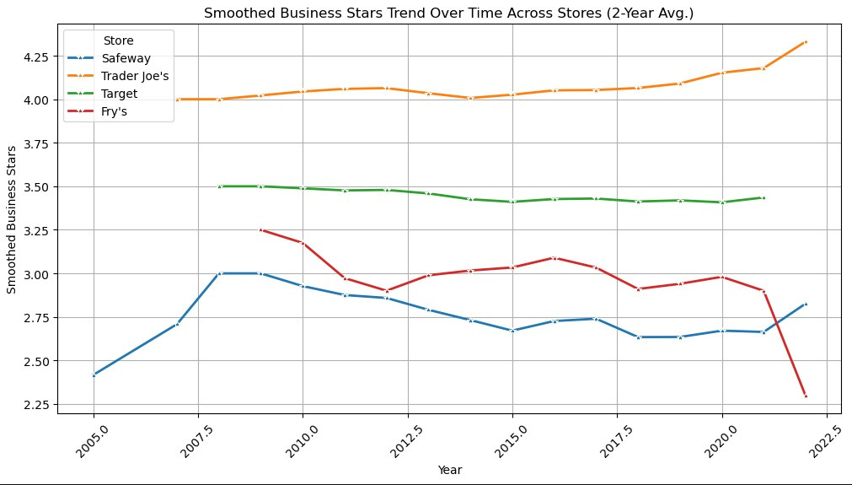
Sentiment & Business~OverTime
Key Takeaways
Trader Joe’s maintains high sentiment & ratings, showing strong customer satisfaction.
Fry’s has a declining trend, indicating growing dissatisfaction.
Target & Safeway show moderate fluctuations but remain relatively stable.
Business Insights
Trader Joe’s → Strong & consistent customer approval
Fry’s → Needs improvement in service & quality
Target → Gradual improvement in sentiment & ratings
Safeway → Stable ratings but fluctuating sentiment

Slide 13
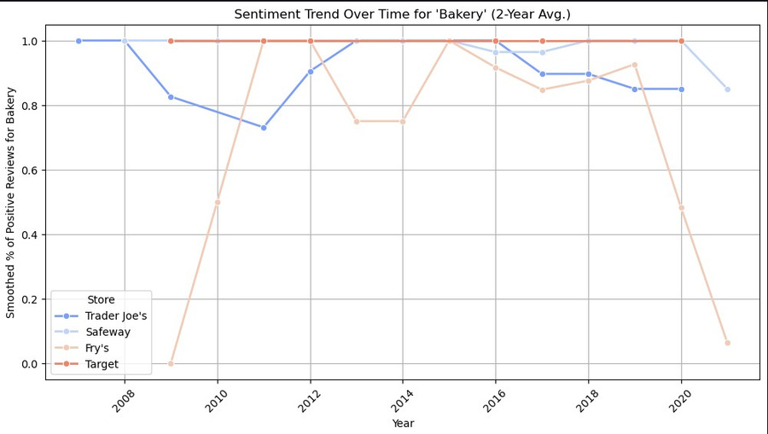
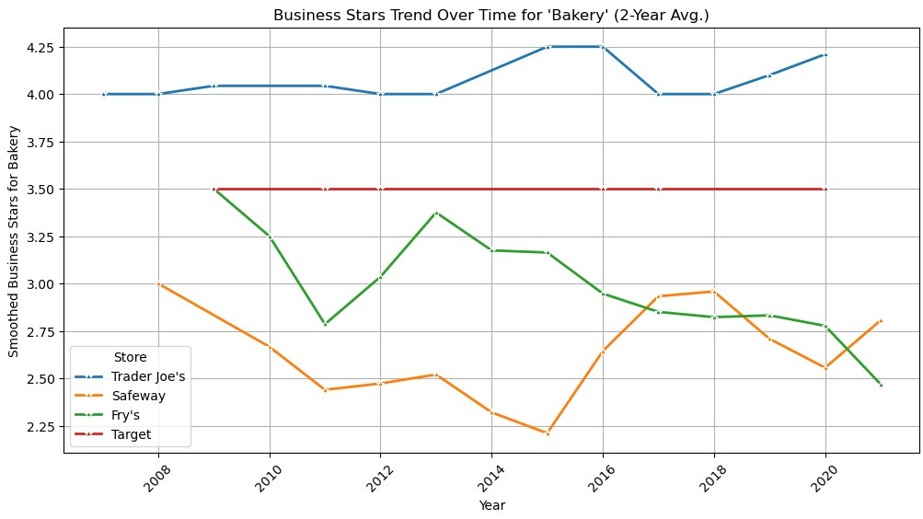
Sentiment & Business ~ Bakery
Key Takeaways
Trader Joe’s → Consistently high positive sentiment & ratings, indicating strong customer loyalty.
Fry’s & Safeway → Declining sentiment and ratings, reflecting growing dissatisfaction with bakery products.
Target → Stable star ratings but fluctuating sentiment, suggesting inconsistent customer experience
Business Insights
Trader Joe’s maintains quality & customer satisfaction in bakery items.
Fry’s & Safeway need improvements in bakery quality & service to regain customer trust.
Target’s bakery sentiment fluctuates, requiring further analysis of customer expectations.

Slide 14

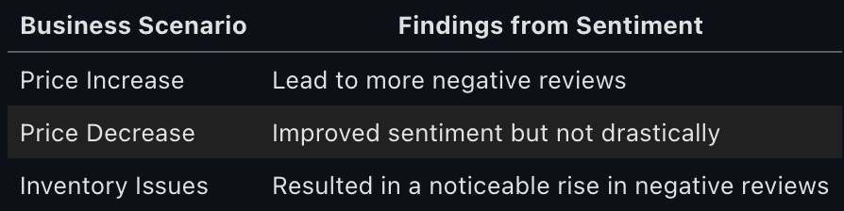
Business Changes! Future Sentiment?
Why Predict Future Sentiment ?
- Enables grocery stores to anticipate customer reactions before making business decisions.
- Provides actionable insights to improve pricing and inventory strategies.
Used BiLSTM model to predict sentiment shifts under these scenarios

Slide 15
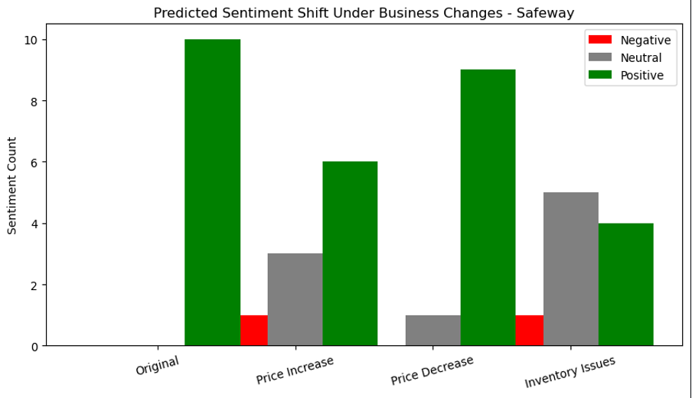
Changes! Future Sentiment?
Key Observations
Price Increase: Decrease in positive sentiment, rise in neutral & negative reviews.
Price Decrease: Slight improvement in positive sentiment, minimal effect on neutral/negative.
Inventory Issues: Significant drop in positive sentiment, sharp rise in negative reviews.
Takeaways
Customers react negatively to price hikes & stock issues.
Optimizing pricing & inventory can help maintain customer satisfaction.

Slide 16


Model Errors & Challenges
Review
Actual
Predicted
Misclassification
Vader Misclassified
I love waiting 30 minutes in a checkout line.
Negative (Sarcasm)
Some models struggled to detect neutrality, often classifying it as positive or negative
Positive
Naïve Bayes Misclassified
The staff was friendly, but the prices were outrageous!
Understanding
Negative
Neutral
Models like Vader & Naïve Bayes misinterpreted sarcastic comments
LSTM Misclassified
Decent selection, but the aisles are always messy.
Neutral
Negative
Long Reviews
RNN Misclassified
Good variety of products, but customer service could be better.
RNN and LSTM-based models faced training difficulties with longer reviews
Neutral
Positive

Slide 17


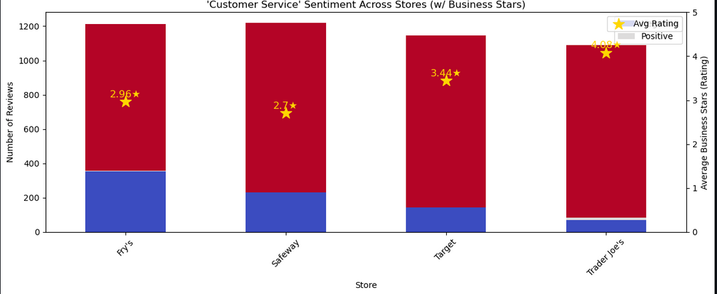
Business Insights
Recommendations
1. Brand Engagement & Sentiment Trends
Trader Joe’s and Target have strong customer loyalty, while Bashas’ and Safeway struggle with engagement.
Sentiment analysis shows fluctuations over time, with dips in 2017 and 2020, possibly due to economic or store policy changes.
2. Key Drivers of Positive & Negative Reviews
Positive factors: Staff friendliness, store cleanliness, and product variety.
Negative factors: Pricing concerns, long checkout times, and stock shortages.
3. Pricing & Shopping Behavior Trends
Customers are highly price-sensitive, especially for fresh produce and specialty items.
Growing demand for organic products, discounts, and online shopping options.
A shift toward digital shopping and home delivery signals the need for improved e-commerce.
1. Improve Customer Service
Train staff for better service & problem resolution.
Use AI sentiment monitoring to detect issues early.
2. Optimize Pricing Strategies
Track competitor pricing to stay competitive.
Use dynamic pricing for frequently mentioned expensive products.
Offer targeted discounts on high-demand items.
3. Enhance Store Efficiency
Reduce checkout wait times with self-checkout expansion.
Optimize store layouts for better navigation.
Use predictive analytics to manage stock levels.

Slide 18
Conclusion
Our data-driven analysis of grocery store reviews highlights key areas impacting customer satisfaction and business performance.
Sentiment Analysis Trends: Customer sentiment has fluctuated over time, influenced by pricing, service quality, and operational bottlenecks. Trader Joe’s and Target maintain strong customer loyalty, while Bashas’ and Safeway need strategic improvements.
Customer Experience Matters: Friendly staff and clean stores drive positive engagement, while long checkout times and poor stock availability lead to negative feedback.
Pricing is a Major Concern: Price-sensitive customers expect competitive pricing—high prices on essentials like fresh produce significantly impact sentiment.
Shift Towards Digital Shopping: Demand for online orders, digital coupons, and seamless e-commerce is increasing, requiring improved technology and logistics.
Future Outlook:
To stay competitive in an evolving retail landscape, grocery stores must adopt data-driven decision-making and AI-powered automation. By continuously analyzing customer sentiment and operational data, businesses can proactively enhance customer experience, optimize pricing, and drive long-term success.

Slide 19


Team 103
Thank You !
Vasu Khanna
Akshara Tirunagari
Aniketh Mysore Ashok
Saranya Korada
Alvin Lee

